Slide 1
Object-Oriented Software Engineering
Chapter 3:
Basing Software Development on
Reusable Technology

Slide 2
Building on the Experience of Others
Software engineers should avoid re-developing software already developed
Types of reuse:
Reuse of expertise
Experience, Article and blog of expert software engineer
Reuse of standard designs and algorithms
There are thousands of algorithms, designs and documentation
Reuse of libraries of classes or procedures
Libraries and commands represent implemented algorithms, data structures and other facilities

Slide 3
Building on the Experience of Others
Reuse of powerful commands built into languages and operating systems
Reuse of frameworks
Frameworks represent more than libraries, they represent the structure of entire applications or subsystems
Reuse of complete applications
Use full application and adapting it to the need of a client by adding a small amount of extra software.
Extra code often called glue code.
Scripting language is used

Slide 4
Frameworks: Reusable Subsystems
A framework is reusable software that implements a generic solution to a generalized problem.
It provides common facilities applicable to different application programs.
Principle: Applications that do different, but related, things tend to have similar designs

Slide 5
Frameworks to promote reuse
A framework is intrinsically incomplete
Certain classes or methods are used by the framework, but are missing (slots)
Some functionality is optional
Allowance is made for developer to provide it (hooks or extension points)
Developers use the services that the framework provides
Taken together the services are called the Application Program Interface (API)

Slide 6
Object-oriented frameworks
In the object oriented paradigm, a framework is composed of a library of classes.
The API is defined by the set of all public methods of these classes.
Some of the classes will normally be abstract and there are often many Interfaces
Example:
A framework for payroll management
Payment, tax, deduction
A framework for frequent buyer clubs
frequent flier or frequent buyer for a supershop
A framework for university registration
A framework for e-commerce web sites

Slide 7
Frameworks and product lines
A product line (or product family) is a set of products built on a common base of technology.
The various products in the product line have different features to satisfy different markets
The software common to all products is included in a framework
Each product is produced by filling the available hooks and slots
E.g. software products offering ‘demo’, ‘lite’ or ‘pro’ versions

Slide 8
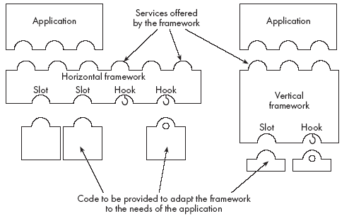
Types of frameworks
A horizontal framework provides general application facilities that a large number of applications can use
A vertical framework (application framework) is more ‘complete’ but still needs some slots to be filled to adapt it to specific application needs

Slide 9
Types of frameworks
Hybrid framework
Composed of vertical and horizontal framework
e-commerce framework consists of horizontal and vertical e.g. secure payment framework
A Java interface can be considered an extreme example of horizontal framework
There is no implementation.
All slots are empty and to be filled

Slide 10
The Client-Server Architecture
A distributed system is a system in which:
computations are performed by separate programs
… normally running on separate pieces of hardware
… that co-operate to perform the task of the system.
Server:
A program that provides a service for other programs that connect to it using a communication channel
Client
A program that accesses a server (or several servers) to obtain services
A server may be accessed by many clients simultaneously

Slide 11
Example of client-server systems
The World Wide Web
Email
Network File System
Transaction Processing System
Remote Display System
Communication System
Database System

Slide 12
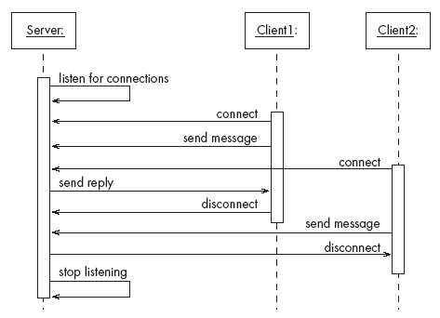
A server program communicating with two client programs

Slide 13
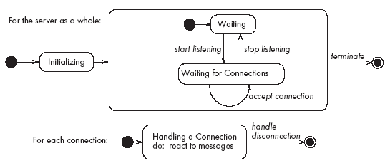
Activities of a server
Initializes itself
Starts listening for clients
Handles the following types of events originating from clients
accepts connections
responds to messages
handles client disconnection
May stop listening
5. Must cleanly terminate

Slide 14
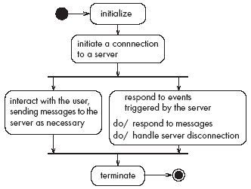
Activities of a client
Initializes itself
Initiates a connection
Sends messages
Handles the following types of events originating from the server
responds to messages
handles server disconnection
Must cleanly terminate

Slide 15
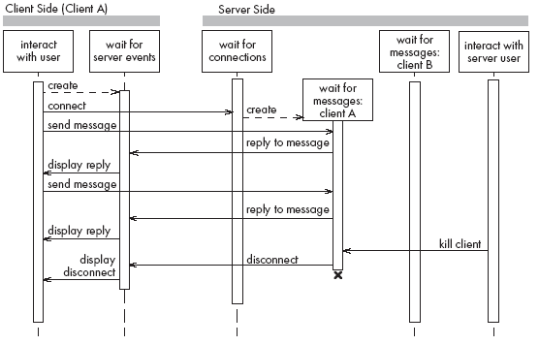
Threads in a client-server system

Slide 16
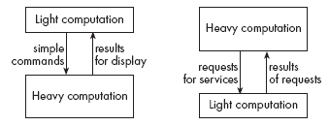
Thin- versus fat-client systems
Thin-client system (a)
Client is made as small as possible
Most of the work is done in the server.
Client easy to download over the network
Fat-client system (b)
As much work as possible is delegated to the clients.
Server can handle more clients

Slide 17
Communications protocols
The messages the client sends to the server form a language.
The server has to be programmed to understand that language.
The messages the server sends to the client also form a language.
The client has to be programmed to understand that language.
When a client and server are communicating, they are in effect having a conversation using these two languages
The two languages and the rules of the conversation, taken together, are called the protocol

Slide 18
Tasks to perform to develop client-server applications
Design the primary work to be performed by both client and server
Design how the work will be distributed
Design the details of the set of messages that will be sent
Design the mechanism for
Initializing
Handling connections
Sending and receiving messages
Terminating

Slide 19
Advantages of client-server systems
The work can be distributed among different machines
The clients can access the server’s functionality from a distance
The client and server can be designed separately
They can both be simpler
There is a choice about where to keep data:
All the data can be kept centrally at the server
Data can be distributed among many different clients or servers
The server can be accessed simultaneously by many clients
Competing clients can be written to communicate with the same server, and vice-versa

Slide 20
Technology Needed to Build Client-Server Systems
Internet Protocol (IP)
Route messages from one computer to another
Long messages are normally split up into small pieces
Transmission Control Protocol (TCP)
Handles connections between two computers
Computers can then exchange many IP messages over a connection
Assures that the messages have been satisfactorily received
A host has an IP address and a host name
Several servers can run on the same host.
Each server is identified by a port number (0 to 65535).
To initiate communication with a server, a client must know both the host name and the port number

Slide 21
Establishing a connection in Java
The java.net package
Permits the creation of a TCP/IP connection between two applications
Before a connection can be established, the server must start listening to one of the ports:
ServerSocket serverSocket = new ServerSocket(port);
Socket clientSocket = serverSocket.accept();
For a client to connect to a server:
Socket clientSocket= new Socket(host, port);

Slide 22
Exchanging information in Java
Each program uses an instance of
InputStream to receive messages from the other program
OutputStream to send messages to the other program
These are found in package java.io
output = clientSocket.getOutputStream();
input = clientSocket.getInputStream();
output =new ObjectOutputStream(clientSocket.getOutputStream());
input =new ObjectInputStream(clientSocket.getInputStream());

Slide 23
Sending and receiving messages
• without any filters (raw bytes)
output.write(msg);
msg = input.read();
• or using DataInputStream / DataOutputStream filters
output.writeDouble(msg);
msg = input.readDouble();
• or using ObjectInputStream / ObjectOutputStream filters
output.writeObject(msg);
msg = input.readObject();

Slide 24
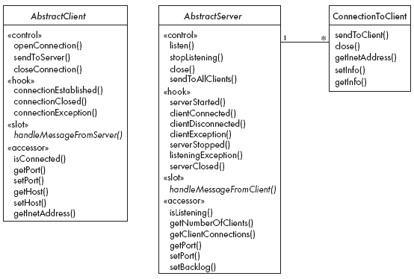
The Object Client-Server Framework (OCSF)

Slide 25
Using OCSF
Software engineers using OCSF never modify its three classes
They:
Create subclasses of the abstract classes in the framework
Call public methods that are provided by the framework
Override certain slot and hook methods (explicitly designed to be overridden)

Slide 26
The Client Side
Consists of a single class: AbstractClient
Must be subclassed
Any subclass must provide an implementation for handleMessageFromServer
Takes appropriate action when a message is received from a server
Implements the Runnable interface
Has a run method which
Contains a loop that executes for the lifetime of the thread

Slide 27
The public interface of AbstractClient
Controlling methods:
openConnection -- connects to a server if it can
closeConnection -- stops communication
sendToServer -- sends a message to server
Accessing methods:
isConnected -- to inquire whether client is connected to a server
getHost -- which host the client is connected to
setHost -- change the host of a disconnected client
getPort -- which port the client is connected to
setPort -- change the port of a disconnected client
getInetAddress – provides detailed information about the client

Slide 28
The callback methods of AbstractClient
Methods that may be overridden:
connectionEstablished
connectionClosed
Method that must be implemented:
handleMessageFromServer

Slide 29
Using AbstractClient
Create a subclass of AbstractClient
Implement handleMessageFromServer slot method
Write code that:
Creates an instance of the new subclass
Calls openConnection
Sends messages to the server using the sendToServer service method
Implement the connectionClosed callback
Implement the connectionException callback

Slide 30
Internals of AbstractClient
Instance variables:
A Socket which keeps all the information about the connection to the server
Two streams, an ObjectOutputStream and an ObjectInputStream
A Thread that runs using AbstractClient’s run method
Two variables storing the host and port of the server

Slide 31
The Server Side
Two classes:
One for the thread which listens for new connections (AbstractServer)
One for the threads that handle the connections to clients (ConnectionToClient)

Slide 32
The public interface of AbstractServer
Controlling methods:
Listen -- listen on the port
stopListening-- no new clients will be accepted
close -- disconnects all client
sendToAllClients -- send message to all clients
Accessing methods:
isListening -- determines if server is listening
getClientConnections -- returns an array of instances of ConnectionToClient
getPort -- what port the server is listening on
setPort -- set a port to listen
setBacklog -- set the size of the client queue length

Slide 33
The callback methods of AbstractServer
Methods that may be overridden:
serverStarted – called when starts accepting connections
clientConnected – when new client connects
clientDisconnected – disconnect a client using close Method of ConnectionToClient
clientException – client disconnects itself or network failure
serverStopped – whenever server stops accepting connections
listeningException -- whenever server stops accepting connections due to some failure
serverClosed – when server closes down
Method that must be implemented:
handleMessageFromClient

Slide 34
The public interface of ConnectionToClient
Controlling methods:
sendToClient – communicate with client
close – causes the client to be disconnected
Accessing methods:
getInetAddress – internet address of the client connection
setInfo – arbitrary information to be saved
getInfo – retreival of information

Slide 35
Using AbstractServer and ConnectionToClient
Create a subclass of AbstractServer
Implement the slot method handleMessageFromClient
Write code that:
Creates an instance of the subclass of AbstractServer
Calls the listen method
Sends messages to clients, using:
the getClientConnections and sendToClient service methods
or sendToAllClients
Implement one or more of the other callback methods

Slide 36
Internals of AbstractServer and ConnectionToClient
The setInfo and getInfo methods make use of a Java class called HashMap
Many methods in the server side are synchronized
The collection of instances of ConnectionToClient is stored using a special JAVA class called ThreadGroup
The server must pause from listening every 500ms to see if the stopListening method has been called
if not, then it resumes listening immediately

Slide 37
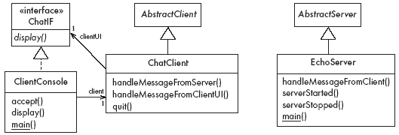
An Instant Messaging Application: SimpleChat
ClientConsole can eventually be replaced by ClientGUI

Slide 38
The server
EchoServer is a subclass of AbstractServer
The main method creates a new instance and starts it
It listens for clients and handles connections until the server is stopped
The three callback methods just print out a message to the user
handleMessageFromClient, serverStarted and serverStopped
The slot method handleMessageFromClient calls sendToAllClients
This echoes any messages

Slide 39
Key code in EchoServer
public void handleMessageFromClient
(Object msg, ConnectionToClient client)
{
System.out.println(
"Message received: "
+ msg + " from " + client);
this.sendToAllClients(msg);
}

Slide 40
The client
When the client program starts, it creates instances of two classes:
ChatClient
A subclass of AbstractClient
Overrides handleMessageFromServer
This calls the display method of the user interface
ClientConsole
User interface class that implements the interface ChatIF
Hence implements display which outputs to the console
Accepts user input by calling accept in its run method
Sends all user input to the ChatClient by calling its handleMessageFromClientUI
This, in turn, calls sendToServer

Slide 41
Key code in ChatClient
public void handleMessageFromClientUI(
String message)
{
try
{
sendToServer(message);
}
catch(IOException e)
{
clientUI.display (
"Could not send message. " +
"Terminating client.");
quit();
}
}

Slide 42
Key code in ChatClient - continued
public void handleMessageFromServer(Object msg)
{
clientUI.display(msg.toString());
}

Slide 43
Risks when reusing technology
Poor quality reusable components
Ensure that the developers of the reusable technology:
follow good software engineering practices
are willing to provide active support
Compatibility not maintained
Avoid obscure features
Only re-use technology that others are also re-using

Slide 44
Risks when developing reusable technology
Investment uncertainty
Plan the development of the reusable technology, just as if it was a product for a client
The ‘not invented here syndrome’
Build confidence in the reusable technology by:
Guaranteeing support
Ensuring it is of high quality
Responding to the needs of its users

Slide 45
Risk when developing reusable technology – continued
Competition
The reusable technology must be as useful and as high quality as possible
Divergence (tendency of various groups to change technology in different ways)
Design it to be general enough, test it and review it in advance

Slide 46
Risks when adopting a client-server approach
Security
Security is a big problem with no perfect solutions: consider the use of encryption, firewalls, ...
Need for adaptive maintenance
Ensure that all software is forward and backward compatible with other versions of clients and servers

